Slide 1
DSO 510: Project 1
Meg Gupta, Mandy Chang, Selena Sun, Alice Lin

Slide 2
Project Goal:
Understand the relationships between Cycle time and several factors through exploratory data visualization and statistical tests, in order to better evaluate and select suppliers.
Variables:
Dependent variable: Cycletime
Independent variables: ForeignMainland, Location, Class, DefectRate, Cost

Slide 3
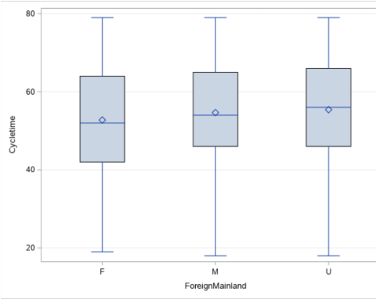
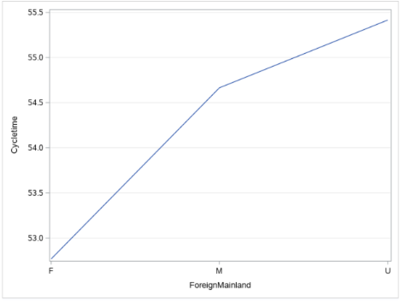
Cycletime x ForeignMainland
Mainland suppliers have greater median Cycle time than foreign suppliers.
Mainland suppliers have greater average Cycle time than foreign suppliers.
→ Mainland suppliers take more time to deliver their products.

Slide 4
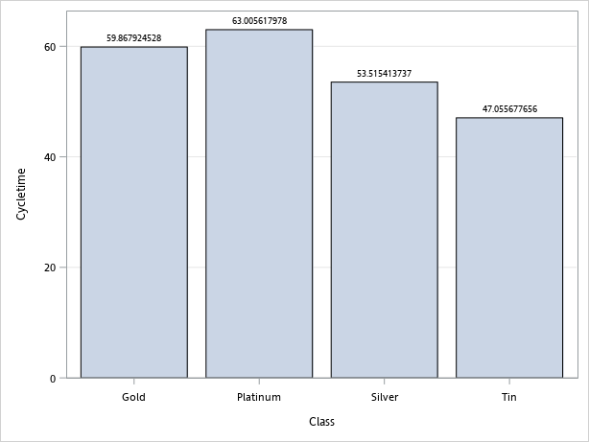
Cycletime x Class
On average, Platinum has the longest cycle time(63 days) and Tin has the shortest cycle time(47 days) amongst all the classes

Slide 5
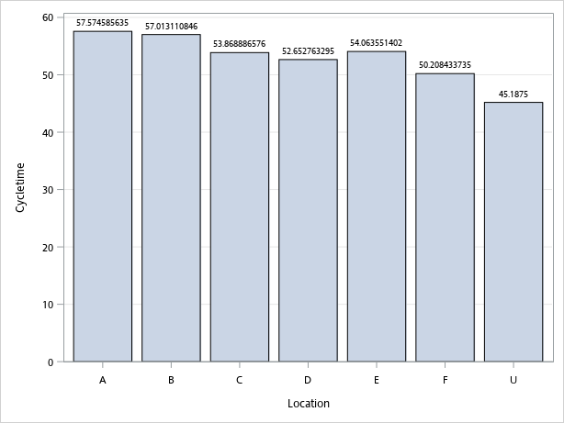
Cycletime x Location
On average, location A has the longest cycle time (58 days) and location F has the shortest cycle time (50 days)
amongst all the classes

Slide 6
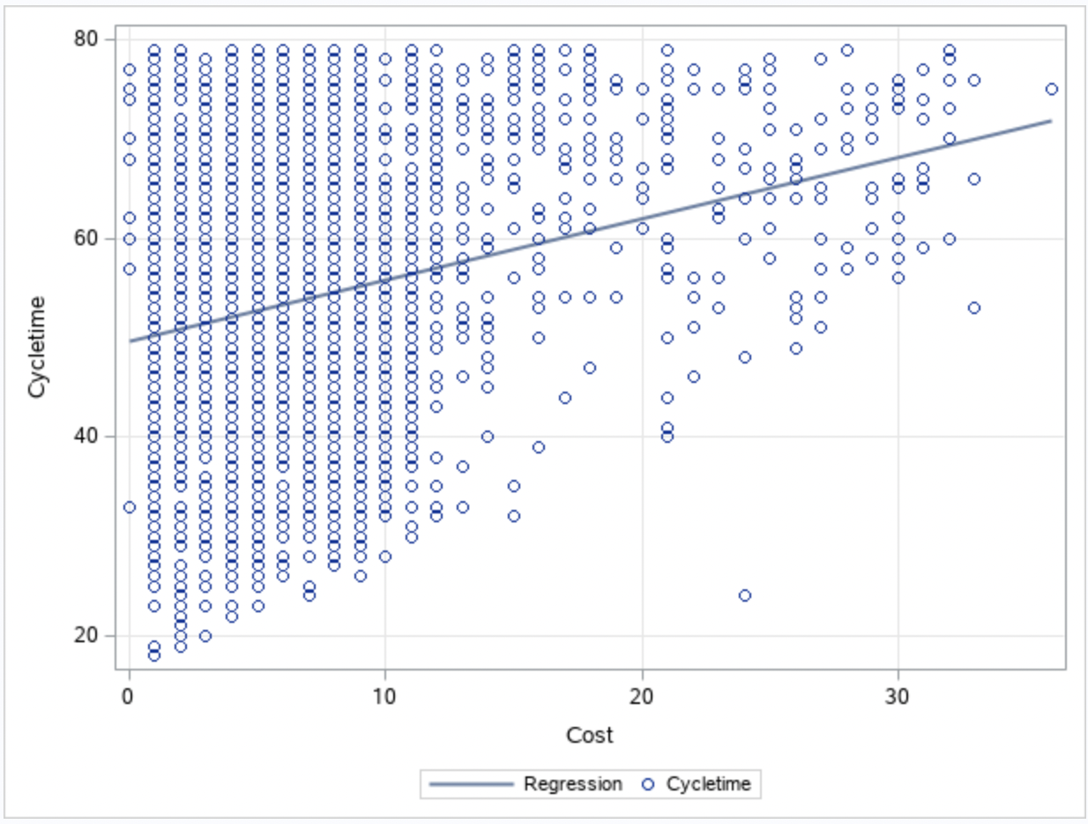
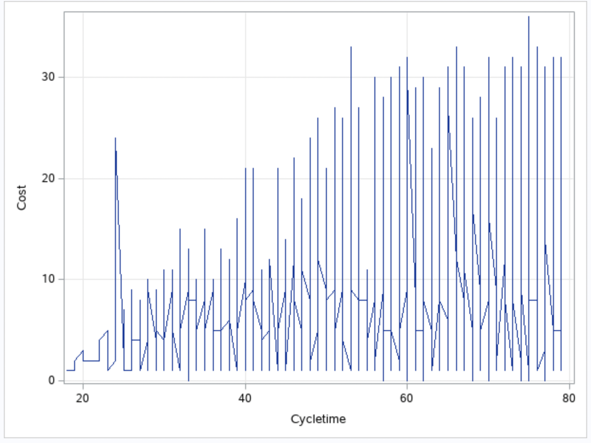
Cycletime x Cost
This scatter plot demonstrates that there is a positive relationship between average Cycle time and average cost. As the cost increased, so did the Cycle time.
This series plot also demonstrates that there is a positive relationship between Cycle time and cost.

Slide 7
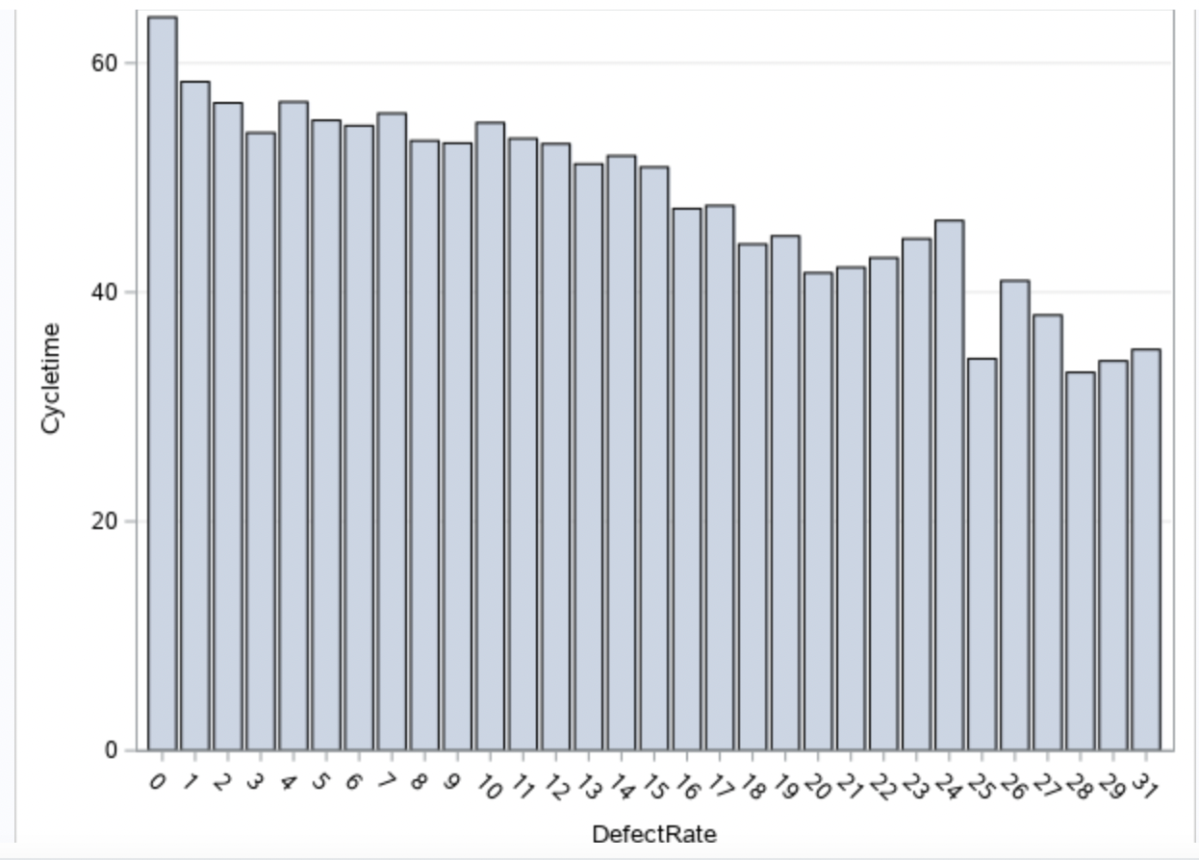
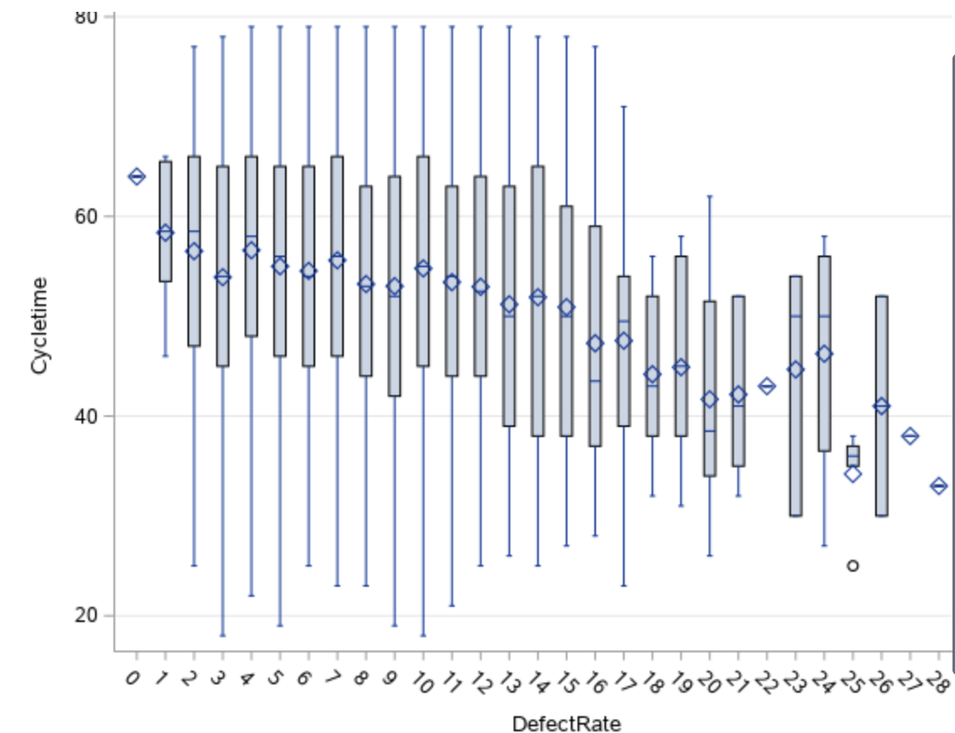
Cycletime x DefectRate
As shown on the bar chart and the box plot, there’s a negative relationship between the defect rate and the cycle time. As the defect rate increases, cycle time decreases.
Notes:
As shown on the bar chart and the box plot, there’s a negative relationship between the defect rate and the cycle time. As the defect rate increases, cycle time decreases.

Slide 8
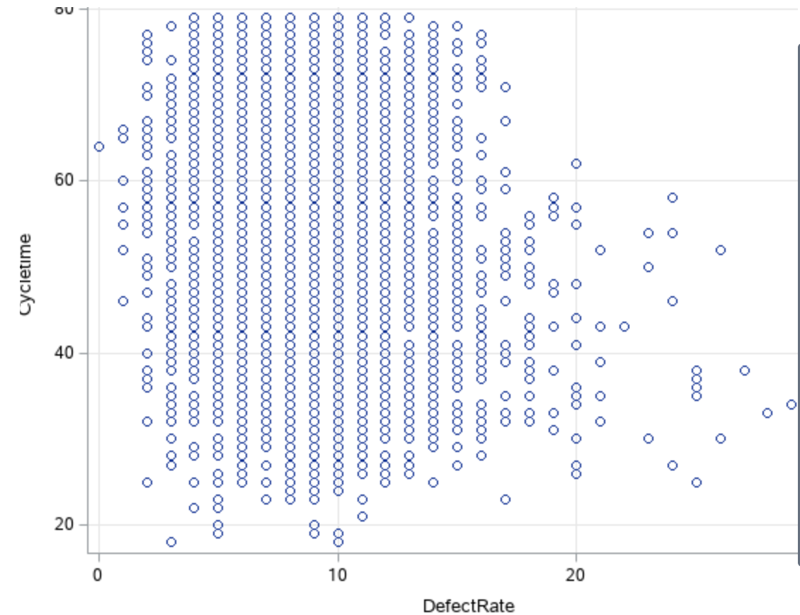
CycleTime x DefectRate
Confirming the previous slide, as shown on the scattered plot, there’s a negative relationship between the defect rate and the cycle time. As the defect rate increases, cycle time decreases.
Notes:
Confirming the previous slide, as shown on the scattered plot, there’s a negative relationship between the defect rate and the cycle time. As the defect rate increases, cycle time decreases.

Slide 9
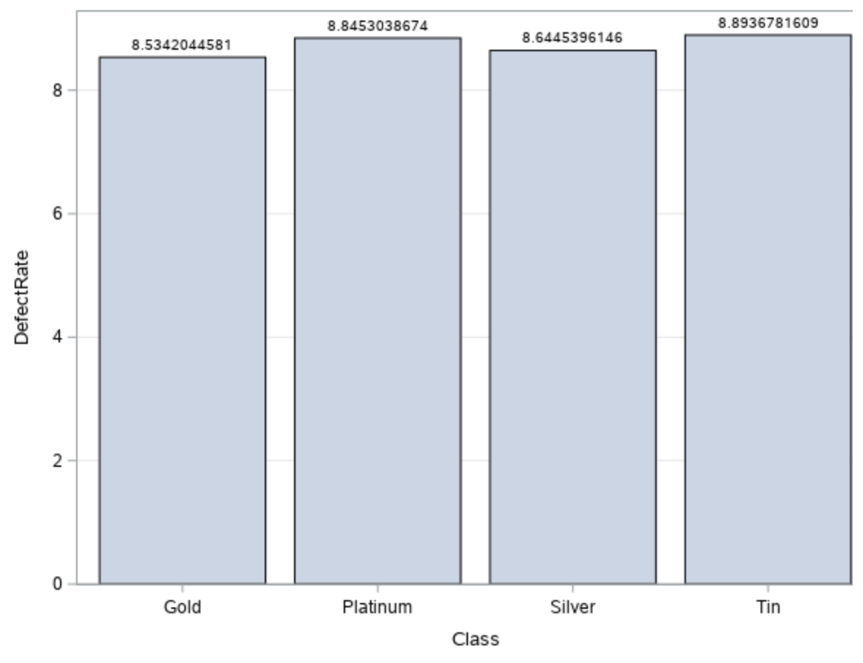
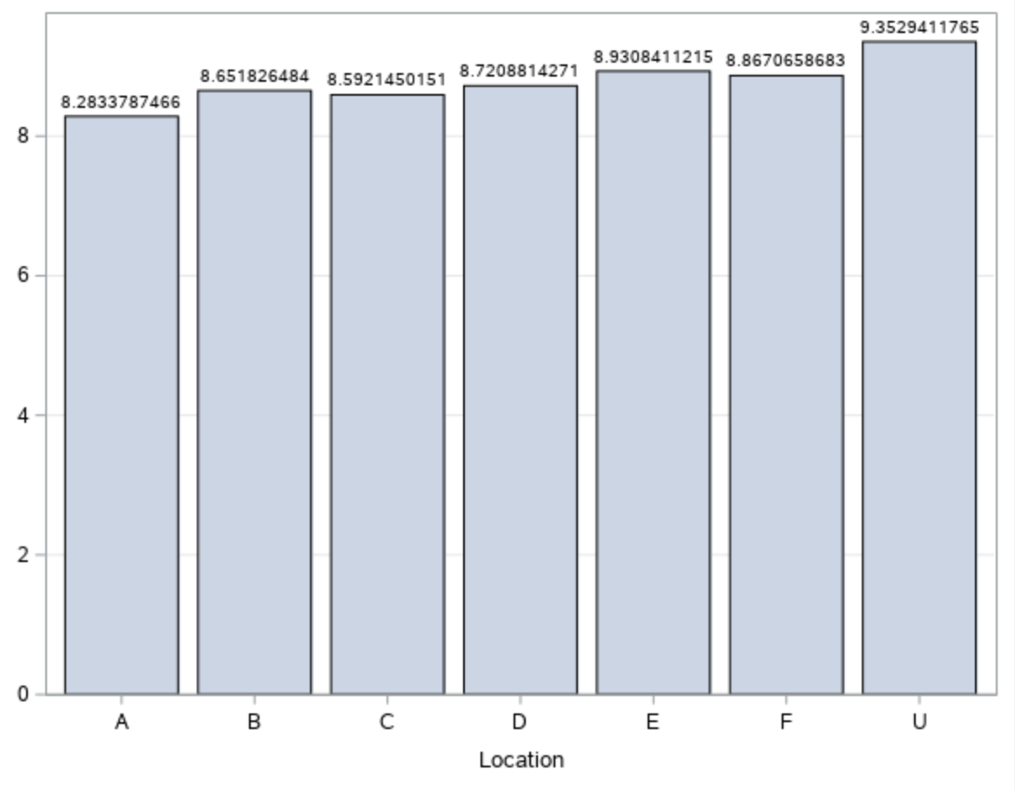
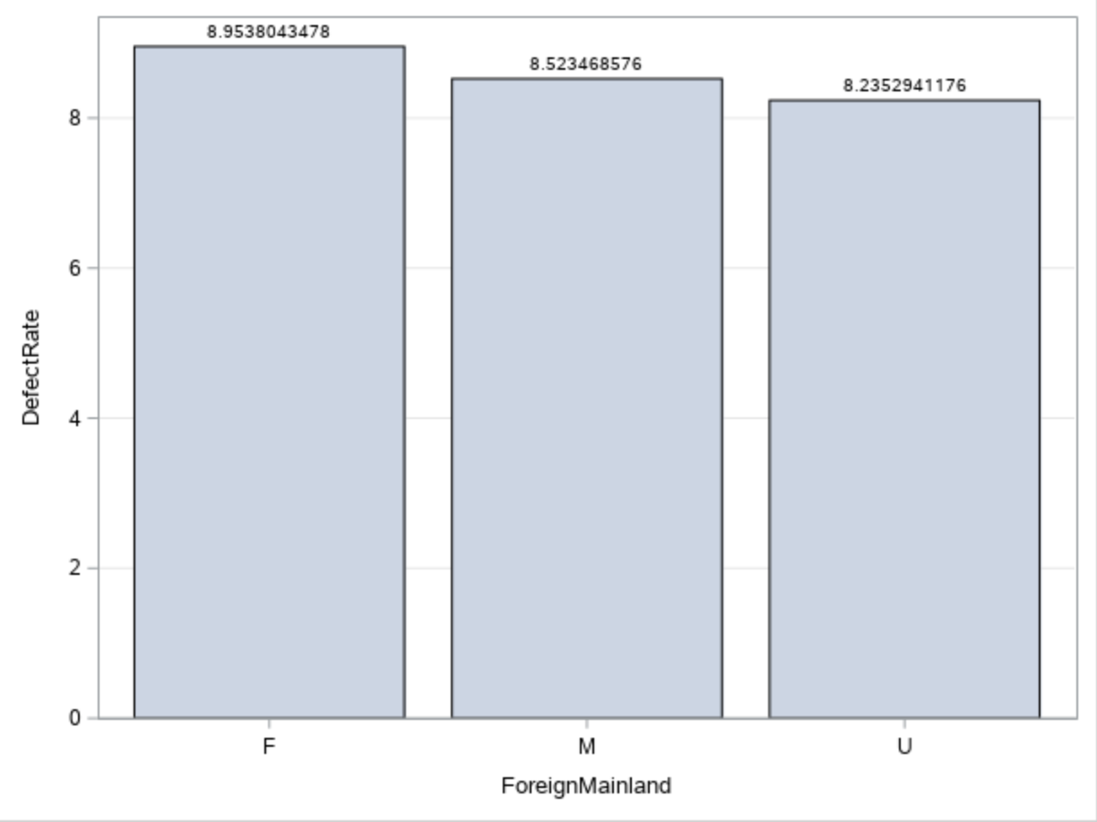
DefectRate x Categorical Variables
Class x DefectRate
Location x DefectRate
ForeignMainland x DefectRate
Suppliers in Tin class have the highest defect rate, but just slightly higher than the supplier in Platinum class.
There are no significant differences of average defect rate between locations.
The foreign suppliers have the higher average defect rate.
Notes:
Confirming the previous slide, as shown on the scattered plot, there’s a negative relationship between the defect rate and the cycle time. As the defect rate increases, cycle time decreases.

Slide 10
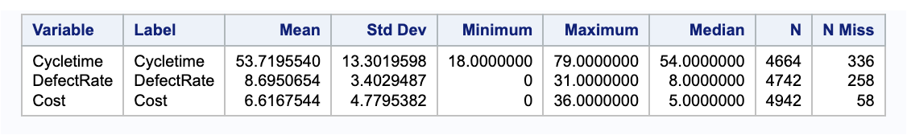
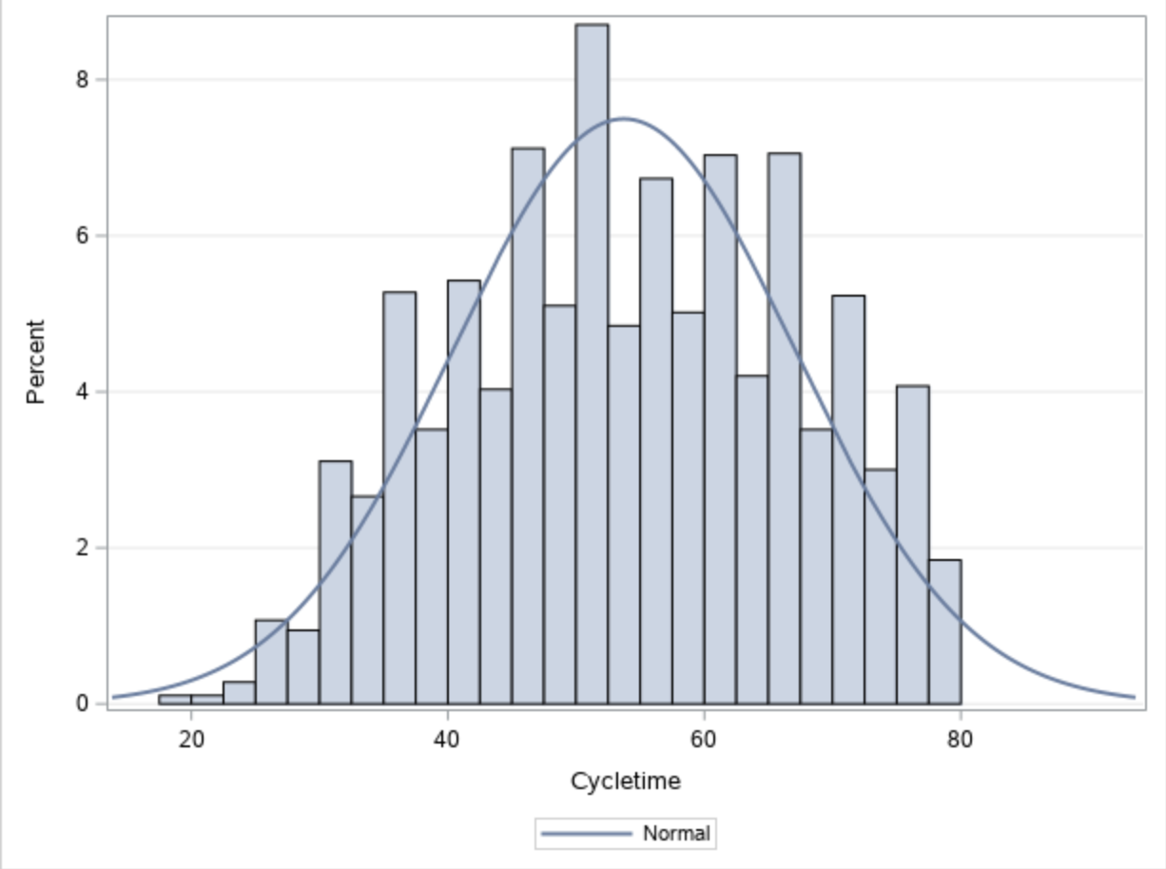
Descriptive Statistics
The Mean and Median of Cycletime are close to each other, which indicates that the data set has a symmetrical distribution (as confirmed by the normal distribution graph on the right)
Cycletime has the largest standard deviation which implies it has much more variance than the other two numerical variables.

Slide 11
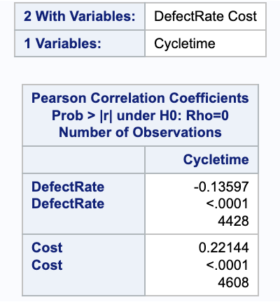
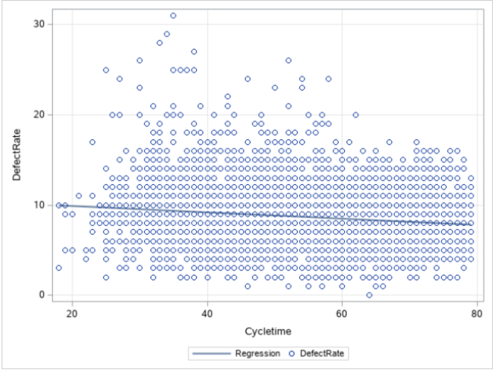
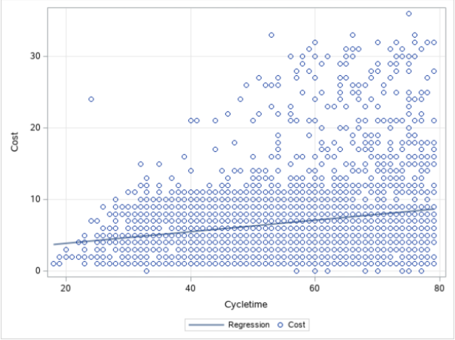
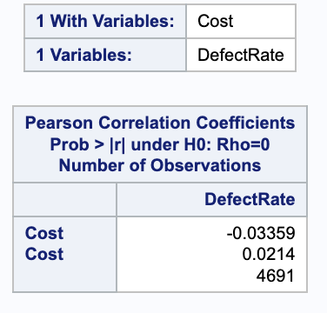
Correlations- the relationship between:
Cycletime and Cost
Cycletime and Defect Rate

Slide 12
Interpretation of Correlations
Cycletime & Defect Rate
The Null Hypothesis is that there is no relationship between Defect Rate and Cost. Since r < 0.05, we can reject the null hypothesis and assume statistical significance. Since the defect rate is -0.135 which is much less than -1, there is a weak negative relationship between Cycle time and Defect Rate.
Cycletime & Cost
The Null Hypothesis is that there is no relationship between Cycle time and Cost. Since r < 0.05, we can reject the null hypothesis and assume statistical significance. Since the cost is 0.22 which is further away from 1, we conclude that there is a weak positive relationship between Cycle time and Cost.

Slide 13
Key Findings
Mainland vs. Foreign suppliers: foreign suppliers had a shorter cycle time
Class - Tin had the shortest cycle time, and Platinum had the longest
Cost – The higher the cost of delivery, the longer the cycle time
Location - Location F had the shortest cycle time, and Location A had the longest.
Defect Rate - The higher the defect rate, the shorter the cycle time (which implies that suppliers that took less time to deliver orders were more likely to have defects)

Slide 14
Recommendations
For companies to be competitive in global markets, their supply chain should be kept efficient and agile. In other words, cycle time should be shortened as much as possible. However, the defect rate should also be as low as possible to guarantee a satisfying shopping experience for customers. Since the defect rate has a negative correlation with the cycle time, there’s a tradeoff that must be made here. We can say that with common sense, it’s more important to promise the quality of delivery than the speed. However, we should not say that the cycle time is not important. It comes secondary when ranking priorities, followed by the cost.
However, as there wasn’t a strong correlation between cycle time and cost or cycle time and defect rate, it is also important to consider other factors including Mainland vs. Foreign suppliers and the class/location of suppliers. For these variables, we would recommend prioritizing foreign suppliers to ensure the most time-efficient deliveries. Between Tin and Platinum classes, we would recommend Tin suppliers because although it has a marginally higher defect rate their cycle time is much shorter.

